Slide 1

Tx HLD Module Images
Prepared for Facebook
September, 2020

Slide 2
Figure 1. Module Framework (Updated)
Strategic Plan & Scope
High Level Network Architecture
Network Design
Deployment
Operations & Maintenance
Field Maintenance
Post-Launch Engineering
Supply Chain Management
Strategy
Business Rules
Service Requirements
Engineering Specifications
Approved Equipment
Site Survey data
Network Design
RAN HLD
RAN LLD
TX Network HLD
TX Network LLD
Civil & Power Design
to Deployment
Mobile Core HLD
Mobile Core LLD
NFVI Dimensioning

Slide 3
Figure 2. Module Functional View
Pre-work Tasks
Inputs
Tx & IP Architecture
Operator Network Data
RAN HLD Design
Commercial Criteria
Service Level Requirements
Tx Standard Configurations Definition
Outputs
Transport Network Solution Design
Transport Design Tasks
Feasibility Analysis
Capacity Planning
Physical Topology Definition
Transport Solution Definition
Bill of Quantities (BoQ)
Fundamentals
Fiber Optic Technology
Microwave Technology
Satellite Technology
IP Protocols Fundamentals
Capacity Planning Principles

Slide 4




Figure 3. Typical Transport Network
eNodeBs
Aggregation
Link
Core
External
Networks
Last-mile
Link
UE traffic served by eNodeBs

Slide 5

Figure 4. Basic structure of a mobile transport network
Base Station
Core Elements
Last-mile
Aggregation
3rd Party
Service relationship (End-to-end)
Networking Layers
Physical
Connectivity
Physical
Connectivity
Physical
Connectivity
Physical
Connectivity
Demarcation node
(CSG)
Packet
Node
Packet
Node
Demarcation node

Slide 6
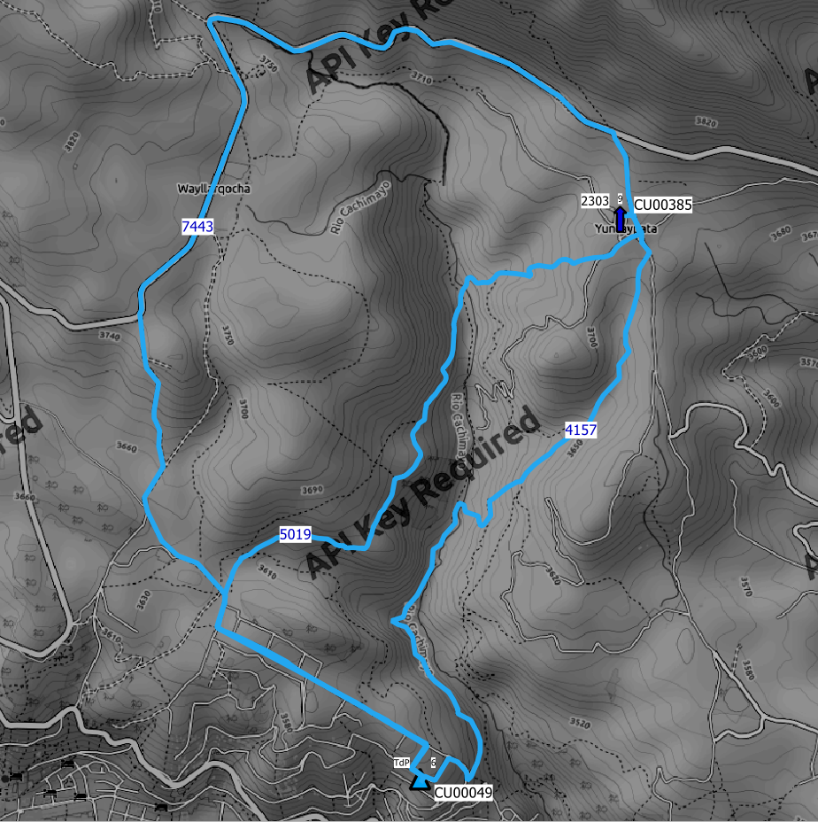
Figure 5. Example of Fiber Path Design
Origin
A
B
C
Destination

Slide 7
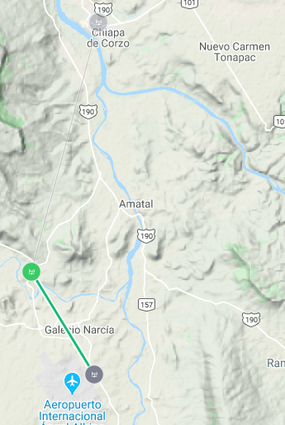
Figure 6. Example scenario of Microwave Link Design
A
11.4km
5.3km
B
Legend
RAN Nodes
Tx Nodes
MW Link

Slide 8
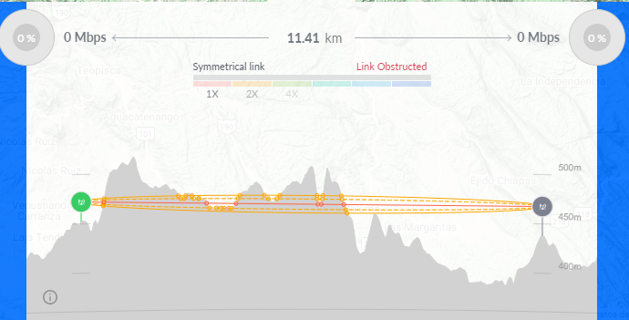
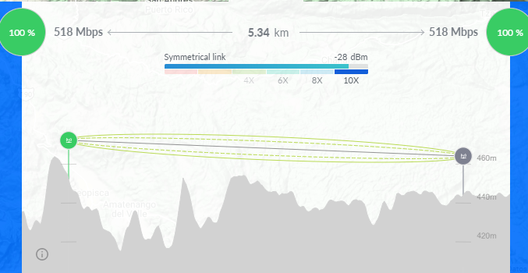
Figure 7. MW Link Profile for Microwave Link Design Scenario
Profile Link A
Profile Link B

Slide 9

Figure 8. Look angles with respect to ES reference
North
θ
φ
Azimuth angle to satellite
Elevation angle to satellite

Slide 10
Figure 9. Illustration of Cell Throughput variations.
Cell Capacity
Peak
Average
Time

Slide 11
Figure 10. Availability calculation for a MW Link.
Outdoor Unit
Outdoor Unit
MW Link
Indoor Unit
Indoor Unit

Slide 12
Figure 11. Availability calculation for a different MW Chain
MW Link
MW Link
2 Hops MW Chain
MW Link
MW Link
MW Link
3 Hops MW Chain

Slide 13
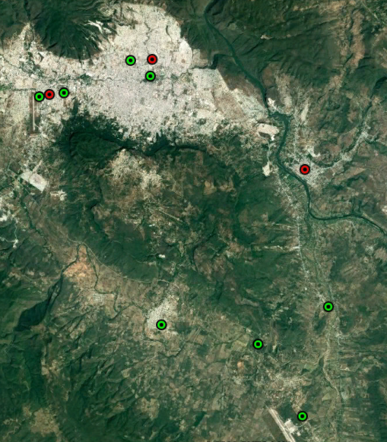
Figure 13. Design Example Scenario.
Legend
RAN Nodes
Tx Nodes

Slide 14
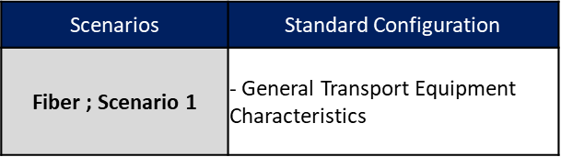
Figure 14. Example of Tx Standard Configurations Definition
Scenarios
Fiber ; Scenario 1
Fiber ; Scenario 2
Microwave ; Scenario 1
Microwave ; Scenario 2
Satellite; Scenario 1
Satellite ; Scenario 2
Technology
Fiber
Microwave
Satellite
Available Technologies
Scenario Identification
Standard Configurations Definition

Slide 15
Figure 16. Transport Solution Feasibility Approaches
Fiber Evaluation
RAN Sites
MW Evaluation
Feasibility Analysis Result
Satellite Evaluation
RAN Sites
Fiber Evaluation
Feasible?
Yes
Approach 1
No
MW Evaluation
Feasible?
Yes
No
Satellite Evaluation
Feasibility Analysis Result
Approach 2

Slide 16
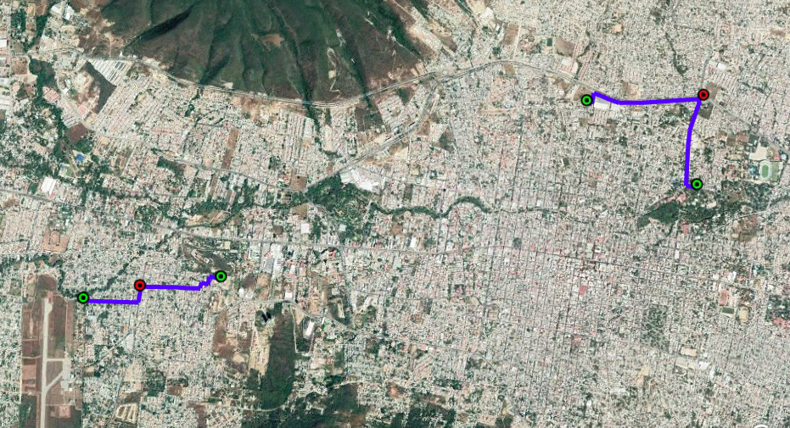
Figure 18. FO Technology Evaluation into Design Example
1.84km
1.52km
1.32km
Legend
RAN Nodes
Tx Nodes
FO Link
0.96km

Slide 17
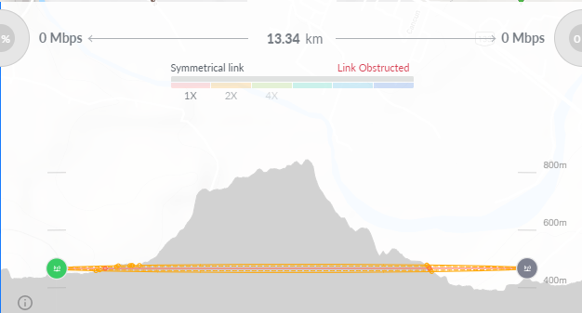
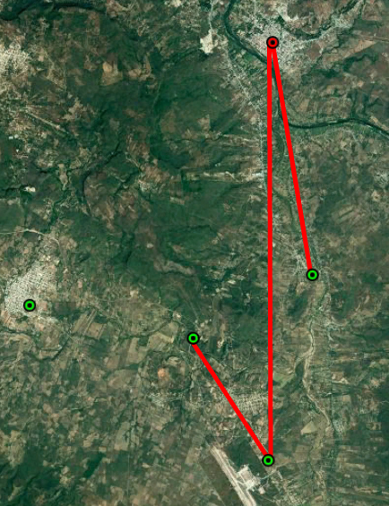
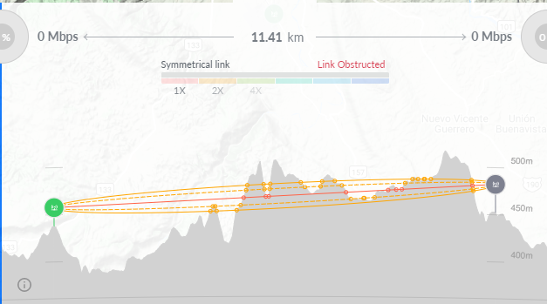
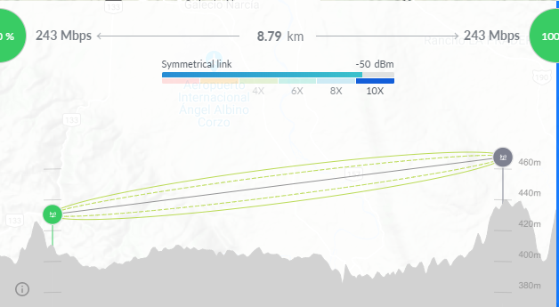
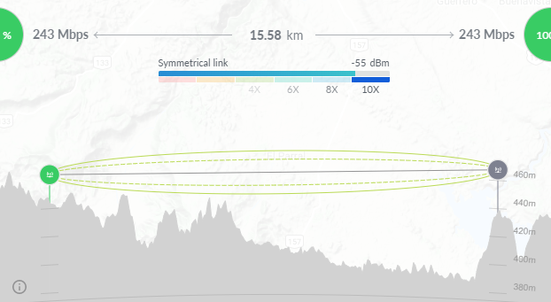
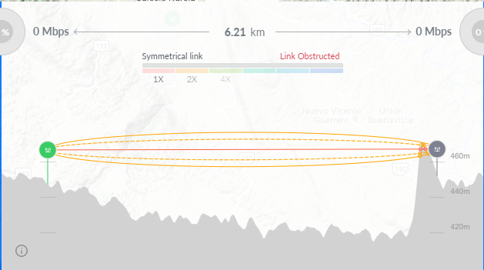
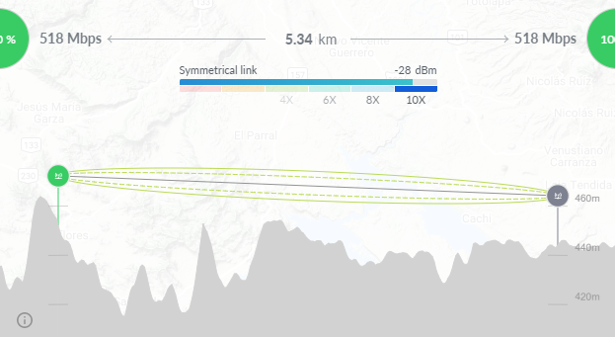
Figure 20. MW Technology Evaluation into Design Example
A
B
No LoS
No LoS
A
C
B
C
D
LoS OK
LoS OK
E
D
E
F
Legend
RAN Nodes
Tx Nodes
LoS MW Link
No LoS MW Link
F
LoS OK
No LoS

Slide 18
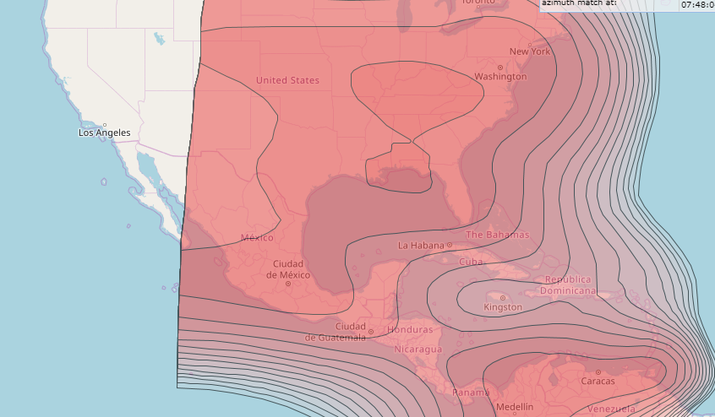
Figure 22. Satellite Technology Evaluation into Design Example
Legend
RAN Nodes
SAT Footprint

Slide 19

Figure 23. Examples of transport network topologies

Slide 20
Figure 24. Topology scenarios presented in Design Example
Fiber Link
MW Link
Scenario 1
Scenario 2
MW Link
MW Link
Scenario 3

Slide 21
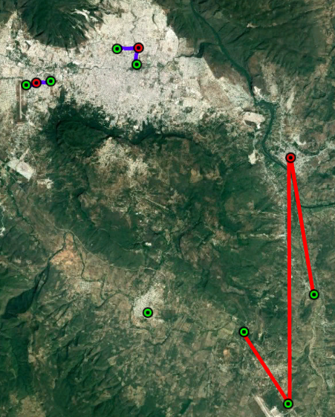
Figure 26. Transport Solution Definition in Design Example
Legend
RAN Nodes
Tx Nodes
Fiber Link
MW Link
Satellite Link

Slide 22
www.telewox.com

